Slide 1




Project Title:-Netflix Analysis
Team ID - CU_CP_Team_9624
Sunny More
Sujal Yadav
Shivam jadav
Sumit Pathak

Slide 2

Project Objectives
Annual Revenue
Analyze trends in movie genres, ratings and Popularity
Problem Statement Low Perfomance
trends over time rating average
Identify top-rated genres and titles,More
Result / Outcomes
Conclusion
Future Perspective

Slide 3
Project overview – Introduction The project utilizes a dataset of 9800+ movies including details like title, release year, genre, popularity, and vote average. Data preprocessing, categorization, and visualization techniques are used to extract insights.

Slide 4
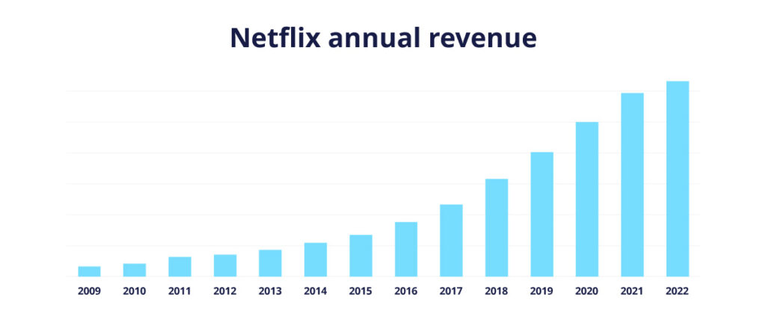
Market Analysis of Netflix

Slide 5
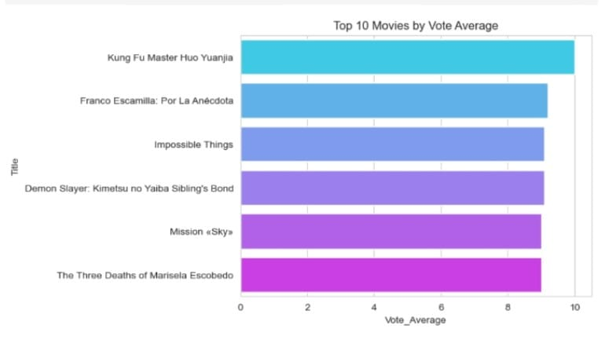
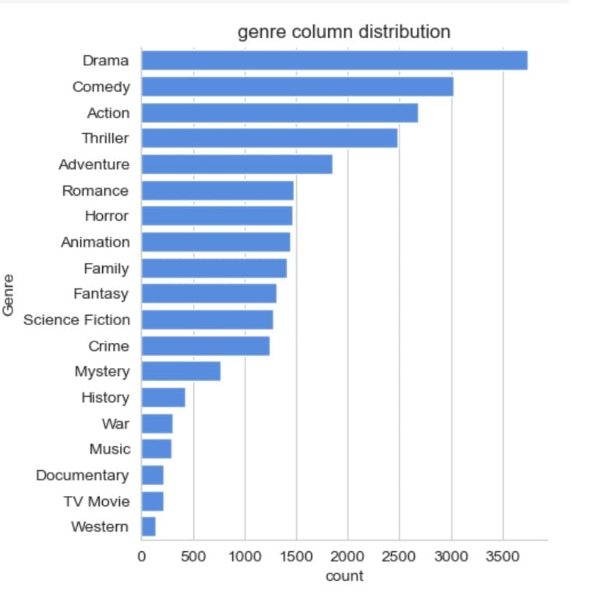
Analyze Trends In Movie Genres
Ratings, and Popularity

Slide 6
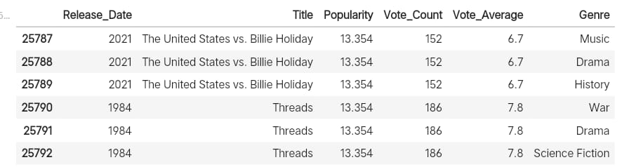
Problem Statement - Analyze trends in movie genres, ratings, and popularity - Clean and preprocess large movie datasets - Visualize distributions and trends over time - Identify top-rated genres and titles Low Perfomance

Slide 7
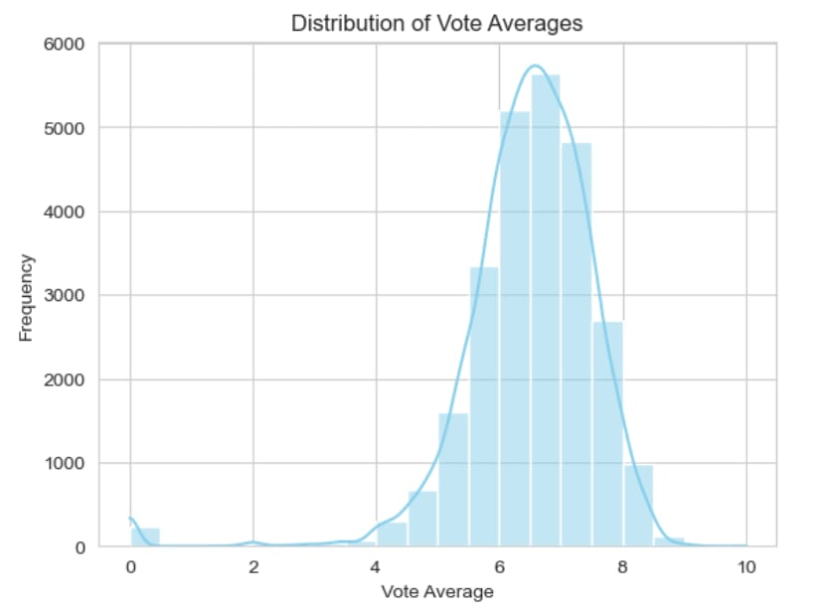
Trends Over Time Rating Average

Slide 8
Result / Outcomes
Most popular movie: Spider-Man: No Way Home
Most common genre: Drama
Vote average distribution is centered around 6.4-7.0
- 19 distinct genres categorized
​

Slide 9
Conclusion The analysis revealed valuable patterns in movie popularity and viewer ratings. Data transformation like genre explosion and vote categorization helped enhance interpretability.

Slide 10
Future Perspective - Incorporate sentiment analysis from reviews - Extend dataset to include TV shows and web series - Deploy as an interactive dashboard - Use reviews to understand how people feel about movies. - Add TV shows and web series to the data. - Create a dashboard that people can click and explore

Slide 11


Thank you...!
Notes:
11

